Slide 1
AWS IonQ Demo
Alex Khan
11/10/2020
Download from https://github.com/AlignedIT/IonQ-Demo-HU

Slide 2
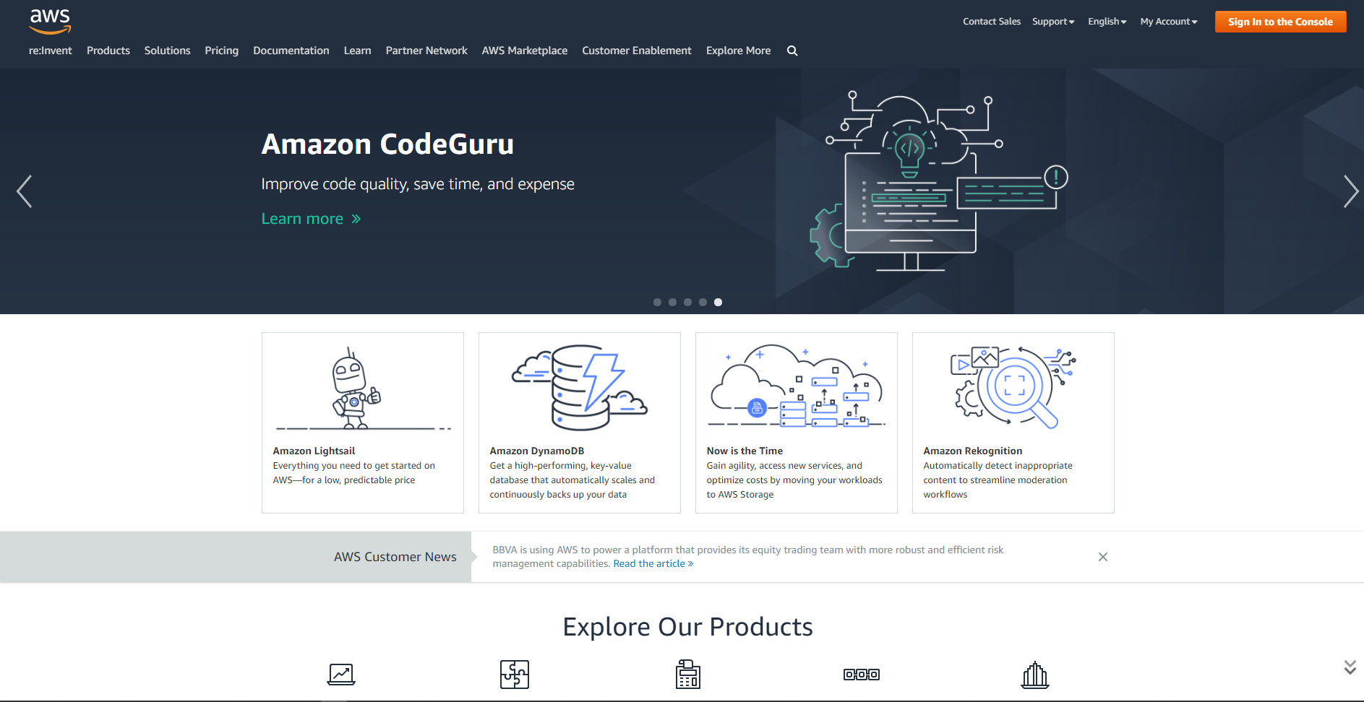

Introduction to Amazon Braket
https://aws.amazon.com/braket/
https://aws.amazon.com/braket/getting-started/

Slide 3
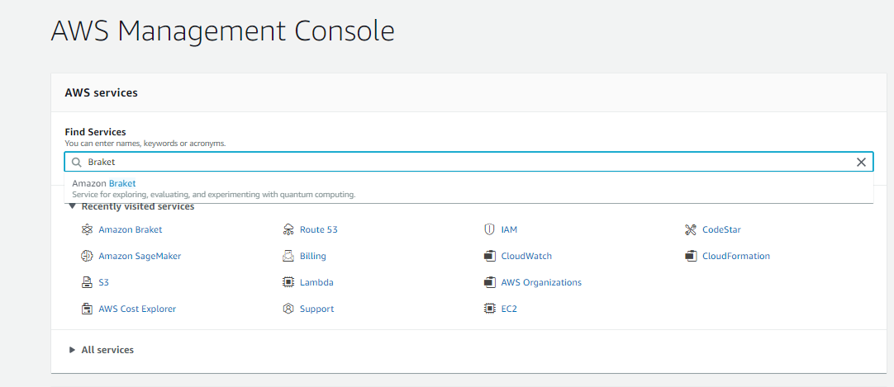
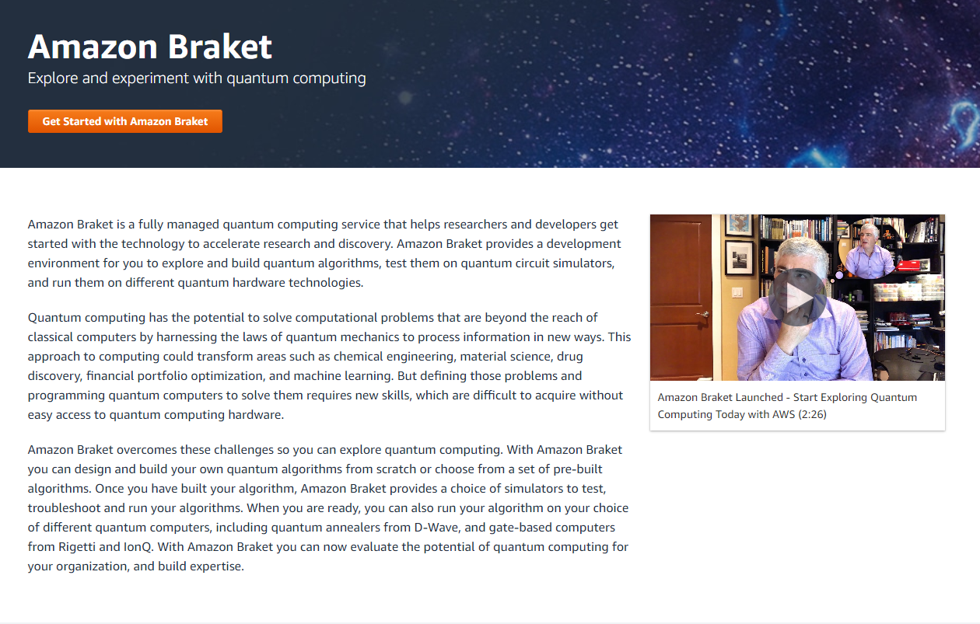
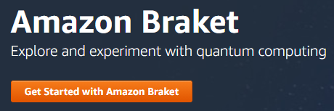
Introduction to Amazon Braket
https://aws.amazon.com/braket/
https://aws.amazon.com/braket/getting-started/

Slide 4
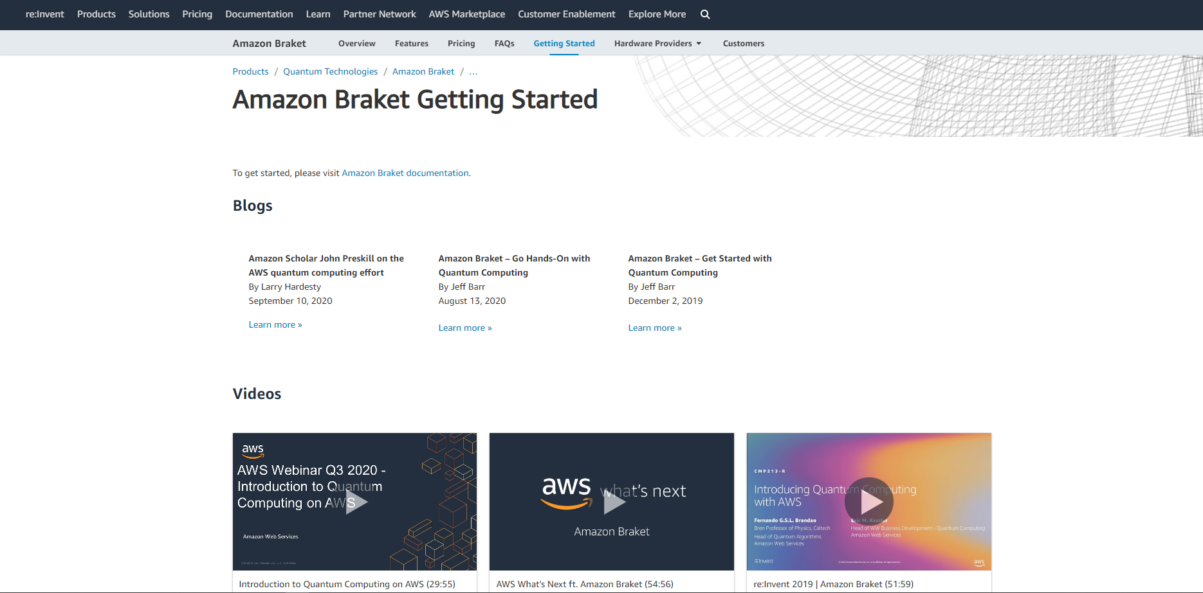
Introduction to Amazon Braket
https://aws.amazon.com/braket/
https://aws.amazon.com/braket/getting-started/

Slide 5
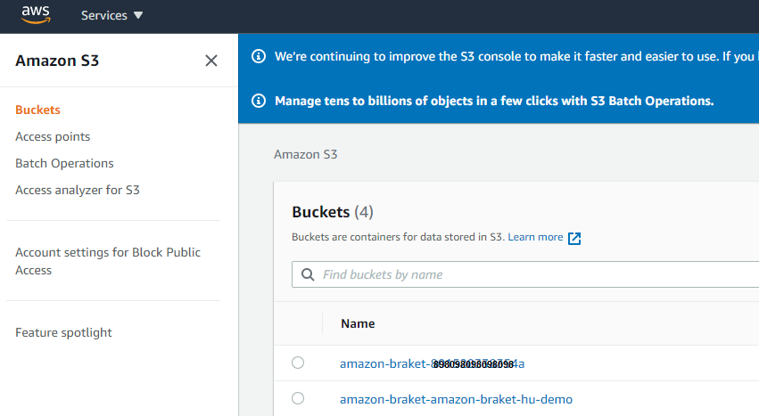
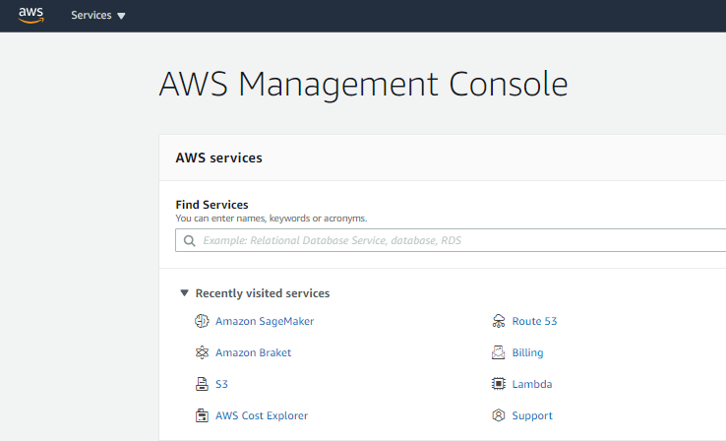
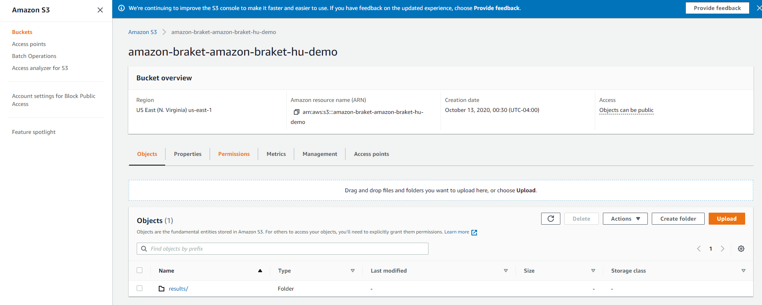
AWS S3 Environment
Copy
For code
1
2. Copy
For code
2

Slide 6
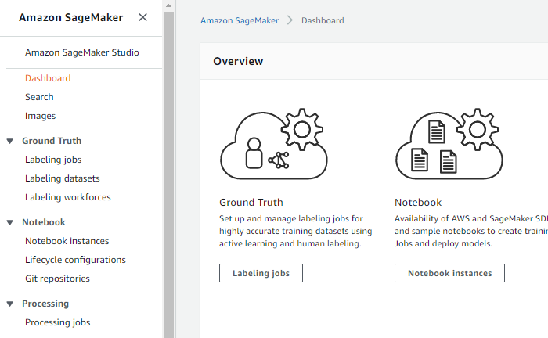
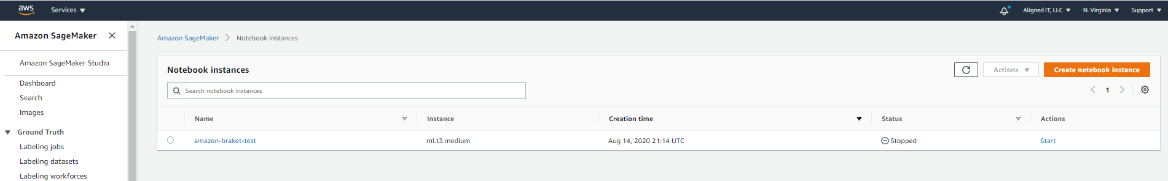
AWS S3 SageMaker
2
1
1. Select Notebook
2. Action: Start
Note Stop from here as well

Slide 7
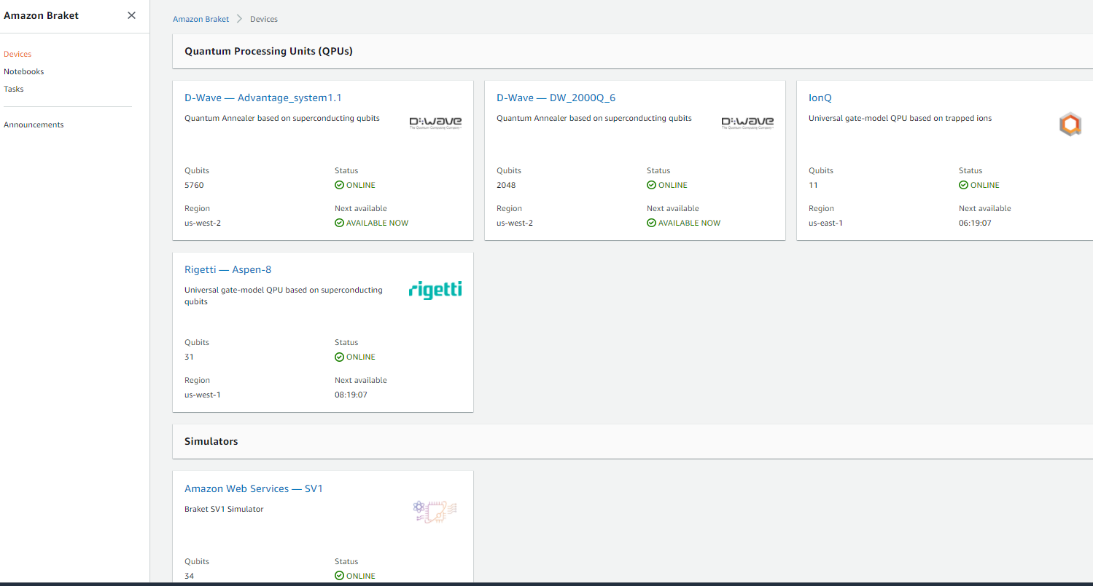
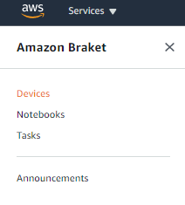
AWS Bracket Environment

Slide 8
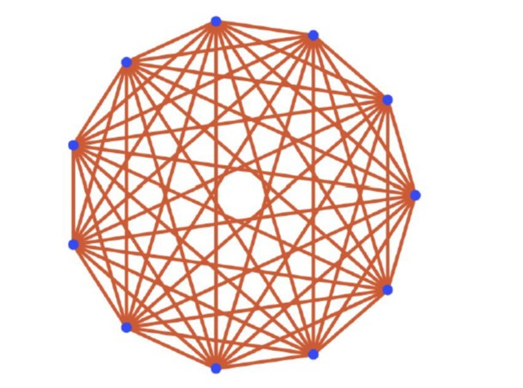
Devices: A bit about IonQ on AWS
Cost
$0.30 / task + $0.01 / shot
Qubits
11
Availability
Weekdays, 13:00:00 - 21:00:00 UTC (8am – 4pm EST)
https://ionq.com/best-practices

Slide 9
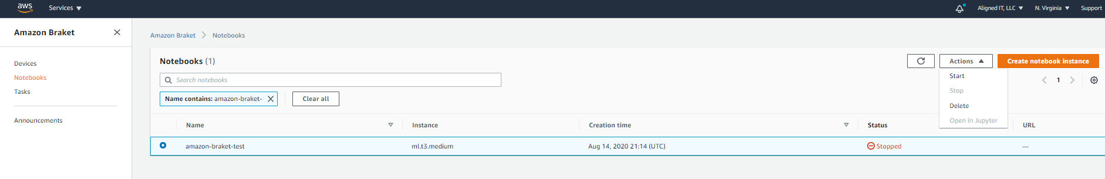
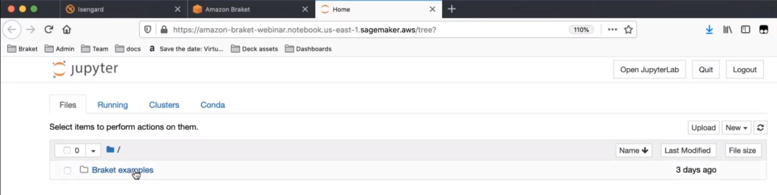
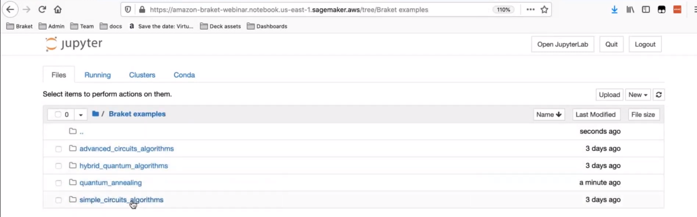
Notebooks: Sample Code
2
1
1. Select Notebook
2. Start Notebook

Slide 10
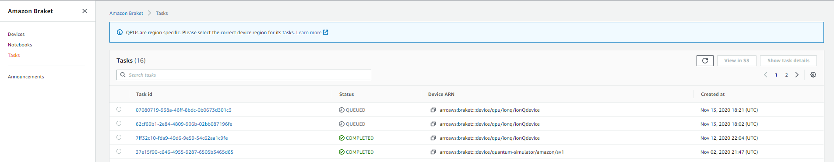
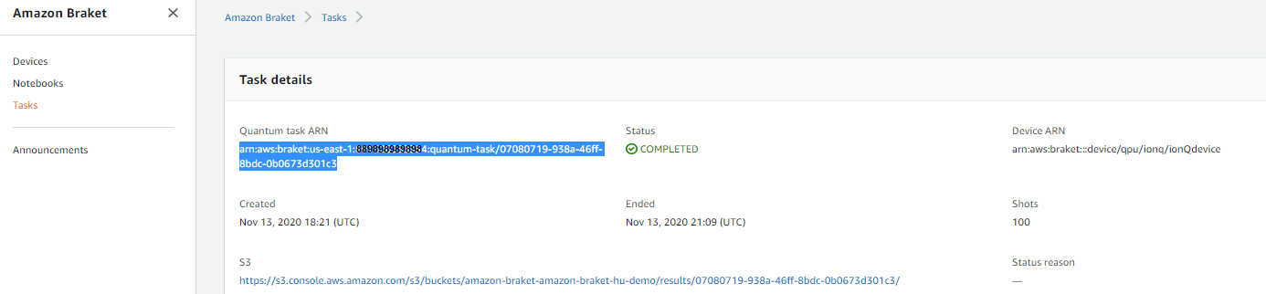
Tasks: Results
1
1. Copy to use in code for task_id

Slide 11
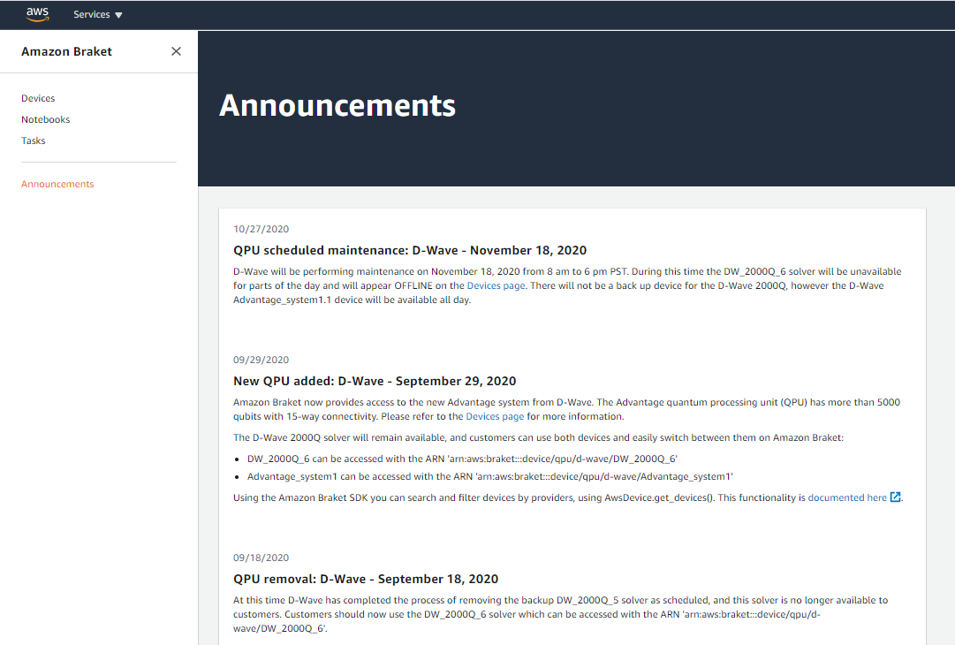
Announcements:

Slide 12
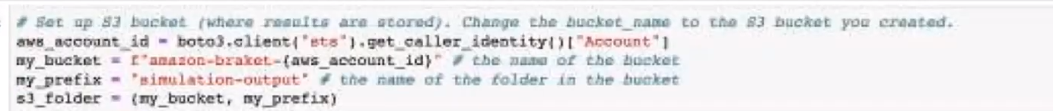
Getting Started with the Code
See Slide 5: S3 Bucket
Note: If default settings are used and bucket name has account ID, then the following code will work
Otherwise, copy paste the S3 Bucket name and the folder name you have created
Name of S3 bucket
Name of S3 bucket folder

Slide 13
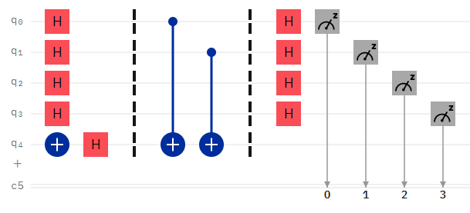
Example 1: Circuit for the Bernstein-Vazirani Algorithm
BV = Circuit().h(range(4)).x(4).h(4).cnot(0,4).cnot(1,4).h(range(4))

Slide 14
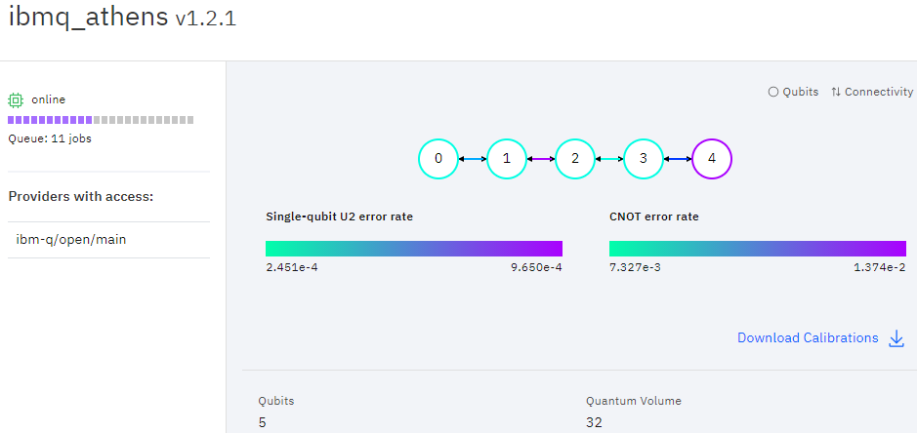
Example 1: Compare using IBM Quantum Hardware
Credit for images: IBM Quantum Experience

Slide 15
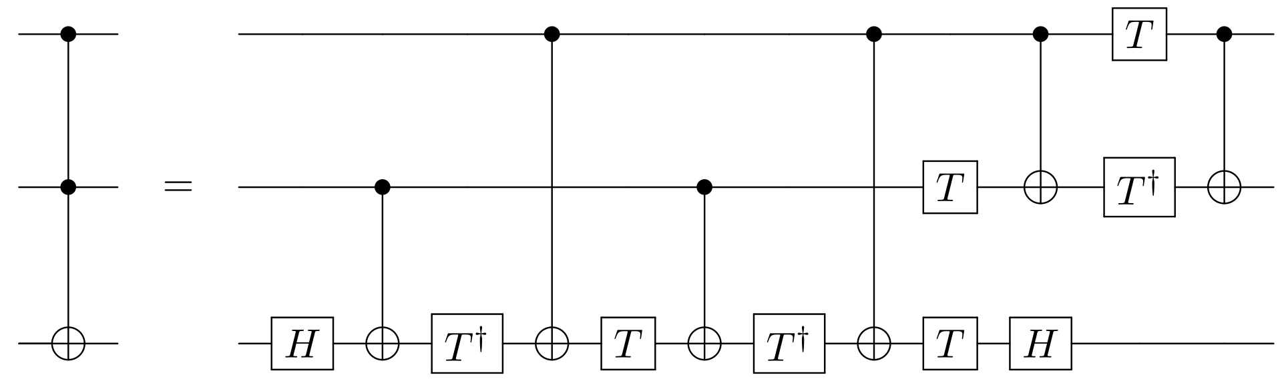
Example 2: Circuit for the Toffoli gate
Toffoli = Circuit().h(2).cnot(1,2).ti(2).cnot(0,2).t(2).cnot(1,2).ti(2).cnot(0,2).t(1).t(2).cnot(0,1).h(2).t(0).ti(1).cnot(0,1)

Slide 16
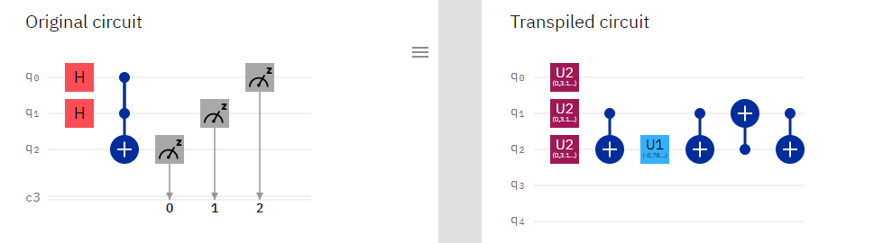
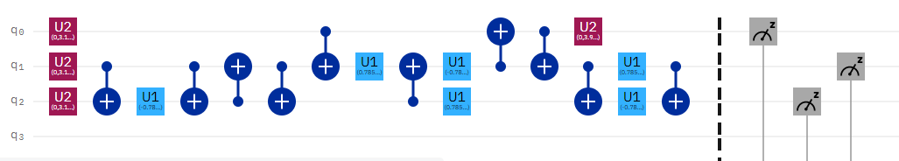
Example 2: Circuit for the Toffoli gate. Transpiling in IBM Quantum

Slide 17
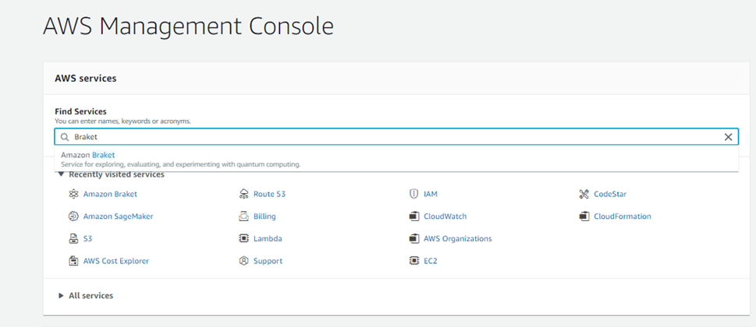
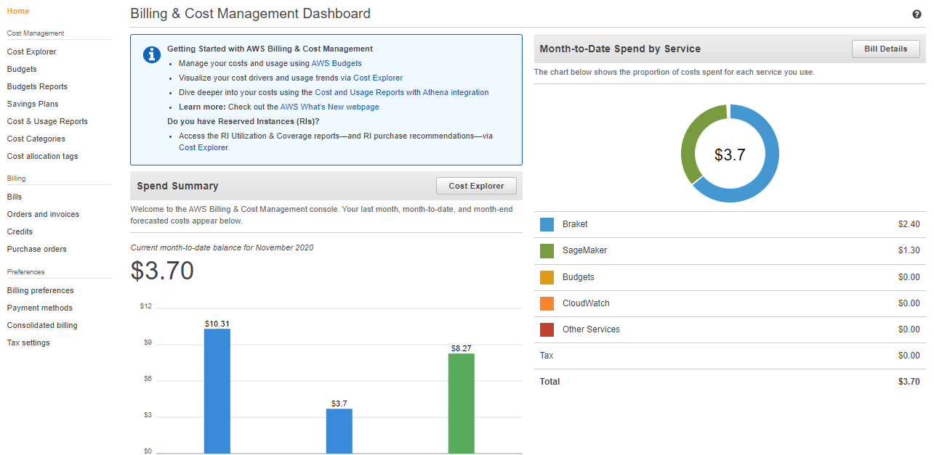
Finishing up
Don’t forget to save your Jupyter notebook by downloading
Don’t forget to STOP the Notebook service
Don’t forget to check Billing (Check back in a week to make sure nothing is left running)

Slide 18
Using local notbooks through AWS Bracket SDK and Boto3
conda create --name aws
conda activate aws
pip install amazon-braket-sdk
pip install boto3
https://github.com/aws/amazon-braket-sdk-python
https://amazon-braket-sdk-python.readthedocs.io/en/latest/index.html
https://boto3.amazonaws.com/v1/documentation/api/latest/guide/quickstart.html

